Slide 1
Quiz Game: IQ Tester
Group Members:
Muhammad Umer 20k-0225
Anas Akhtar 20k-0422
Instructors:
Sir M Nauman Duraani
Sir Kariz Kamal

Slide 2
Why did we chose this project?

Slide 3
Problem
With the rising of technology, people are more attracted towards it. Technology has been involved in each and every field and is keep on growing. Just like that, we are observing an involvement of tech in education too. With the rising challenges, we need an enhanced and innovative education which can only be possible with the help of computers and technologies. In schools and colleges, we found that teachers experience difficulties in designing quizzes for evaluation of what students have learnt so far. Most of the time the papers on which teacher design quizzes are lost or leaked. Or the key of the quiz is leaked too. It is very difficult for teachers to design multiple quizzes to avoid this, which results in false evaluation.

Slide 4
Solution and Brief Description
To make the evaluation easier, we have designed a project which will help teachers in designing quizzes more efficiently.
Our quiz game is solely designed with help of Assembly Language. It contains questions based on IQ and mathematical sequences to test IQ of a person. Every time you run the program, you will get different questions in different orders, generated automatically by the program itself, to avoid any cheating or copying of key when more than one person is attempting the quiz.

Slide 5
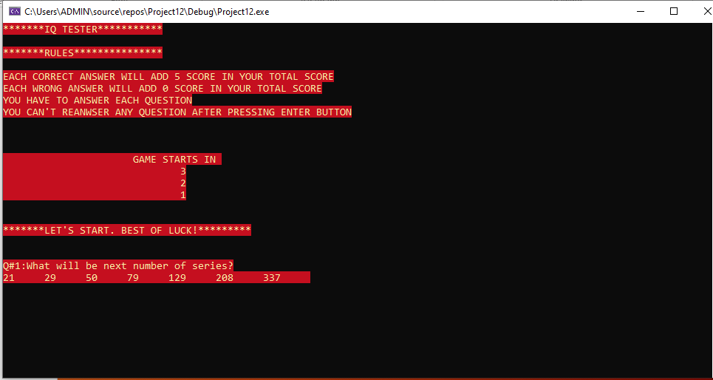
Additional features
In addition to this, the program will award you 5 points with every correct answer, and will add it to your total score. With every wrong answer no point will be awarded, and you would not get another chance to attempt that particular question. At the end, after attempting all the questions, total number of correct attempts, total number of wrong attempts and your total score would be printed.

Slide 6
Domain of Questions in Quiz
Quiz will consist of question regarding following concepts:
Fibonacci Series
Factorial
Quadruple
Natural number
Perfect number
Perfect square (p)
Binary series
Hexadecimal series
Leap Year Series

Slide 7
Assembly Language Concepts
In this project, you will find all most all of the assembly language concepts, e.g.
User defined Functions
Delay Function
Color Changing Function
Randomize Function

Slide 8
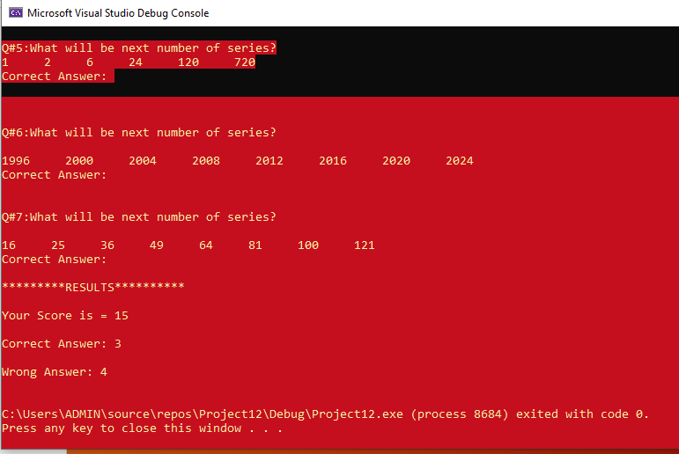
Basic Operations :
Loops
Jmp (Jumps)
Inc
Dec
Call
CMP (Comparing)
And all others

Slide 9
THANKYOU

